Slide 1
Careers you did not think of in IT
Richard Fennell
Engineering Director, Black Marble

Slide 2
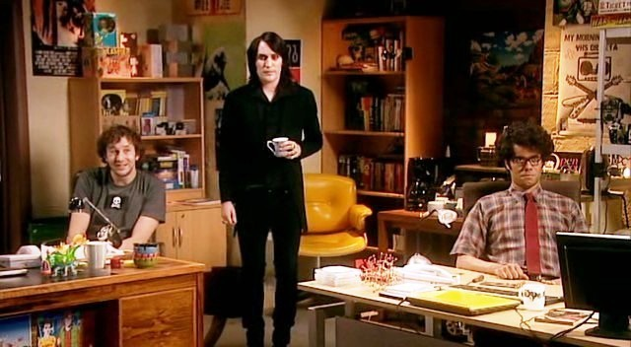
Is this your image of a career in IT?

Slide 3















Most people are consumers
Notes:
Every organisation uses IT today, you will in most careers
But in most jobs you will used IT as a consumer as you do at home

Slide 4
Why not be a creator?
All Businesses
IT Companies

Slide 5
Teacher
Translators
Developer
Graphic Designer
Database Administrator
Project Manager
Quants
Trainer
Tester
Business Analyst
Technical Support
Marketing
IT Management
Hardware Designer
Sales
Animator
Evangelist
Technical Writer
Installation Engineer
Data Scientists
Technical Sales
3D Artist
Network Security
Architects
Notes:
Some of these exist in most companies
Some only in software development companies

Slide 6
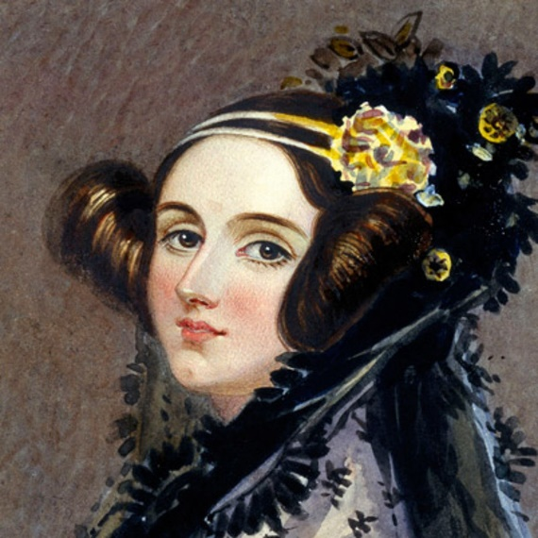
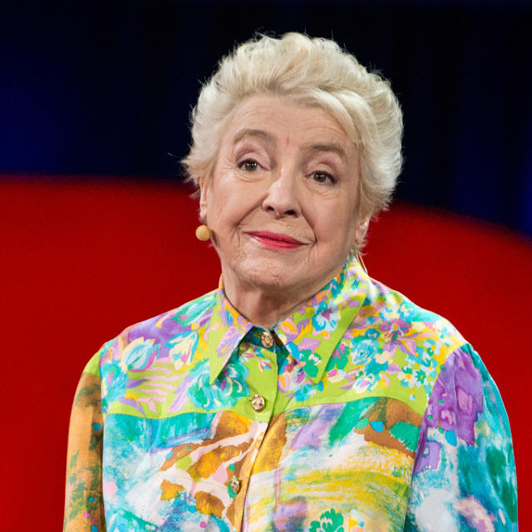
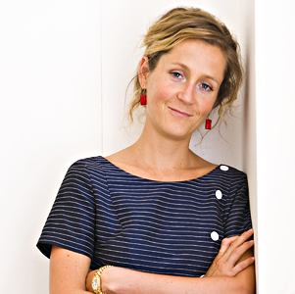
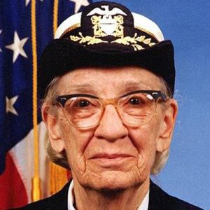
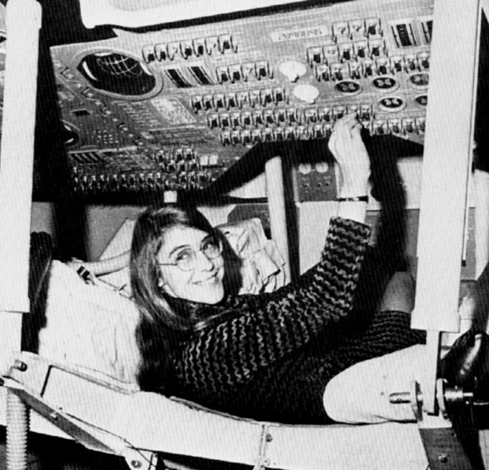
Not just a career path for the boys
Ada Lovelace
Dame Stephanie Shirley
Martha Lane Fox
Rear Admiral Grace Hopper
Margaret Hamilton
Notes:
Ada Lovelace 1840s – First Programmer
– worked with Charles Babbage in the difference engine, daughter of Lord Byron
Grace Hopper 1950s onwards – First High Level Language
– worked on the development of the Cobol Language, standardised the language whilst an Admiral in US Navy
Dame Stephanie Shirley – 1960s onwards – First Software Only Company
– first true software company, women working from home
Margaret H. Hamilton – 1960s onwards – First Downloadable Programs
- led the team that created the on-board flight software for NASA's Apollo command modules and lunar modules.
Martha Lane Fox – 2000s onwards – Not all tech roles – built one of the few .DOTCom boom successes
- Founder of LastMinute.com
More details…..
Ada Lovelace
Throughout her life, Lovelace was strongly interested in scientific developments and fads of the day, including phrenology^{[45]} and mesmerism.^{[46]} After her work with Babbage, Lovelace continued to work on other projects. In 1844 she commented to a friend Woronzow Greig about her desire to create a mathematical model for how the brain gives rise to thoughts and nerves to feelings ("a calculus of the nervous system").^{[47]} She never achieved this, however. In part, her interest in the brain came from a long-running pre-occupation, inherited from her mother, about her 'potential' madness. As part of her research into this project, she visited the electrical engineer Andrew Crosse in 1844 to learn how to carry out electrical experiments.^{[48]} In the same year, she wrote a review of a paper by Baron Karl von Reichenbach, Researches on Magnetism, but this was not published and does not appear to have progressed past the first draft.^{[49]} In 1851, the year before her cancer struck, she wrote to her mother mentioning "certain productions" she was working on regarding the relation of maths and music.^{[50]}
Lovelace first met Babbage in June 1833, through their mutual friend Mary Somerville. Later that month Babbage invited Lovelace to see the prototype for his Difference Engine.^{[51]} She became fascinated with the machine and used her relationship with Somerville to visit Babbage as often as she could. Babbage was impressed by Lovelace's intellect and analytic skills. He called her The Enchantress of Numbers. In 1843 he wrote of her:
Forget this world and all its troubles and if possible its multitudinous Charlatans—every thing in short but the Enchantress of Numbers.^{[52]}
During a nine-month period in 1842–43, Lovelace translated the Italian mathematician Luigi Menabrea's article on Babbage's newest proposed machine, the Analytical Engine. With the article, she appended a set of notes.^{[53]}Explaining the Analytical Engine's function was a difficult task, as even other scientists did not really grasp the concept and the British establishment was uninterested in it.^{[54]} Lovelace's notes even had to explain how the Engine differed from the original Difference Engine.^{[55]} Her work was well received at the time; the scientist Michael Faraday described himself as a supporter of her writing.^{[56]}
The notes are around three times longer than the article itself and include (in Section G^{[57]}), in complete detail, a method for calculating a sequence of Bernoulli numbers with the Engine, which would have run correctly had the Analytical Engine been built (only his Difference Engine has been built, completed in London in 2002).^{[58]} Based on this work Lovelace is now widely considered the first computer programmer^{[1]} and her method is recognised as the world's first computer program.^{[59]}
Section G also contains Lovelace's dismissal of artificial intelligence. She wrote that "The Analytical Engine has no pretensions whatever to originate anything. It can do whatever we know how to order it to perform. It can follow analysis; but it has no power of anticipating any analytical relations or truths." This objection has been the subject of much debate and rebuttal, for example by Alan Turing in his paper "Computing Machinery and Intelligence".
Lovelace and Babbage had a minor falling out when the papers were published, when he tried to leave his own statement (a criticism of the government's treatment of his Engine) as an unsigned preface—which would imply that she had written that also. When Taylor's Scientific Memoirs ruled that the statement should be signed, Babbage wrote to Lovelace asking her to withdraw the paper. This was the first that she knew he was leaving it unsigned, and she wrote back refusing to withdraw the paper. The historian Benjamin Woolley theorised that, "His actions suggested he had so enthusiastically sought Ada's involvement, and so happily indulged her ... because of her 'celebrated name'."^{[60]} Their friendship recovered, and they continued to correspond. On 12 August 1851, when she was dying of cancer, Lovelace wrote to him asking him to be her executor, though this letter did not give him the necessary legal authority. Part of the terrace at Worthy Manor was known as Philosopher's Walk, as it was there that Lovelace and Babbage were reputed to have walked while discussing mathematical principles.^{[56]}
Grace Hopper
UNIVAC[edit]
In 1949, Hopper became an employee of the Eckert–Mauchly Computer Corporation as a senior mathematician and joined the team developing the UNIVAC I.^{[17]} In the early 1950s, the company was taken over by theRemington Rand corporation, and it was while she was working for them that her original compiler work was done. The compiler was known as the A compiler and its first version was A-0.^{[20]:11}
In 1952 she had an operational compiler. "Nobody believed that," she said. "I had a running compiler and nobody would touch it. They told me computers could only do arithmetic."^{[21]}
In 1954 Hopper was named the company's first director of automatic programming, and her department released some of the first compiler-based programming languages, including MATH-MATIC and FLOW-MATIC.^{[17]}
COBOL[edit]
Grace Murray Hopper at the UNIVAC keyboard, c. 1960
In the spring of 1959, a two-day conference known as the Conference on Data Systems Languages (CODASYL) brought together computer experts from industry and government. Hopper served as a technical consultant to the committee, and many of her former employees served on the short-term committee that defined the new language COBOL (an acronym for COmmon Business-Oriented Language). The new language extended Hopper's FLOW-MATIC language with some ideas from the IBM equivalent, COMTRAN. Hopper's belief that programs should be written in a language that was close to English (rather than in machine code or in languages close to machine code, such as assembly languages) was captured in the new business language, and COBOL went on to be the most ubiquitous business language to date.^{[22]}
From 1967 to 1977, Hopper served as the director of the Navy Programming Languages Group in the Navy's Office of Information Systems Planning and was promoted to the rank of Captain in 1973.^{[19]} She developed validation software for COBOL and its compiler as part of a COBOL standardization program for the entire Navy.^{[19]}
Dame Stephanie Shirley
After leaving school Vera decided not to go to university to study biology (the "only science then available to my gender") but instead to seek employment in a mathematics/technical environment.^{[6]} At the age of 18, she became a British citizen and changed her name to Stephanie Brook.^{[6]}
In the 1950s, Shirley worked at the Post Office Research Station at Dollis Hill, building computers from scratch and writing code in machine language.^{[7]} She took evening classes for six years to obtain a degree in mathematics. In 1959, she moved to CDL Ltd, manufacturers of the ICT 1301 computer.
In 1962, Shirley founded, with a capital of £6, the software company Freelance Programmers,^{[3]} (later Xansa since acquired by Steria and now part of the Sopra Steria Group). She wanted to create job opportunities for women with dependents, and predominantly employed women, with only 3 male programmers of a total of over 300,^{[8]} until the Sex Discrimination Act 1975 made that practice illegal. She adopted the name,Steve, to help her in the male-dominated business world.^{[9]} Her team's projects included programming Concorde's black box flight recorder.^{[1][10]}
Shirley retired in 1993 at the age of 60 and has since focused on her philanthropy.
Margaret Hamilton
Margaret H. Hamilton led the team that created the on-board flight software for NASA's Apollo command modules and lunar modules. A mathematician and computer scientist who started her own software company, Hamilton contributed to concepts of asynchronous software, priority scheduling and priority displays, and human-in-the-loop decision capability, which set the foundation for modern, ultra-reliable software design and engineering.
http://arstechnica.com/tech-policy/2016/11/top-apollo-era-navy-computer-scientists-receive-presidential-medal-of-freedom/
Martha Lane Fox
Martha Lane Fox, Baroness Lane-Fox of Soho, CBE is a British businesswoman, philanthropist, and public servant. Lane Fox co-founded Lastminute.com in the dotcom boom of the early 2000s and has subsequently served on public service digital projects. Wikipedia

Slide 7
You are going to need IT skills
But don’t just be a consumer
Learn the basics concepts of coding so you can contribute
Notes:
You are going to need IT skills
But don’t just be a consumer
Learn the basics of coding so you can contribute

